Slide 1
Defining Privacy
Privacy related to notion of access
Access
  Physical proximity to a person
  Knowledge about a person
Privacy is a “zone of inaccessibility”
Privacy violations are an affront to human dignity
Too much individual privacy can harm society
Where to draw the line?
1-<number>

Slide 2
Harms of Privacy
Cover for illegal or immoral activities
Burden on the nuclear family
Hidden dysfunctional families
Ignored people on society’s fringes
1-<number>

Slide 3
Benefits of Privacy
Individual growth
Individual responsibility
Freedom to be yourself
Intellectual and spiritual growth
Development of loving, trusting, caring, intimate relationships
1-<number>

Slide 4
Is There a Natural Right to Privacy?
Privacy rights stem from property rights: “a man’s home is his castle”
Coercive Acts before American Revolution led to 3rd Amendment to U.S. Constitution
Samuel Warren and Louis Brandeis: People have “the right to be let alone”
Judith Jarvis Thomson: “Privacy rights” overlap other rights
Conclusion: Privacy is not a natural right, but it is a prudential right
1-<number>

Slide 5
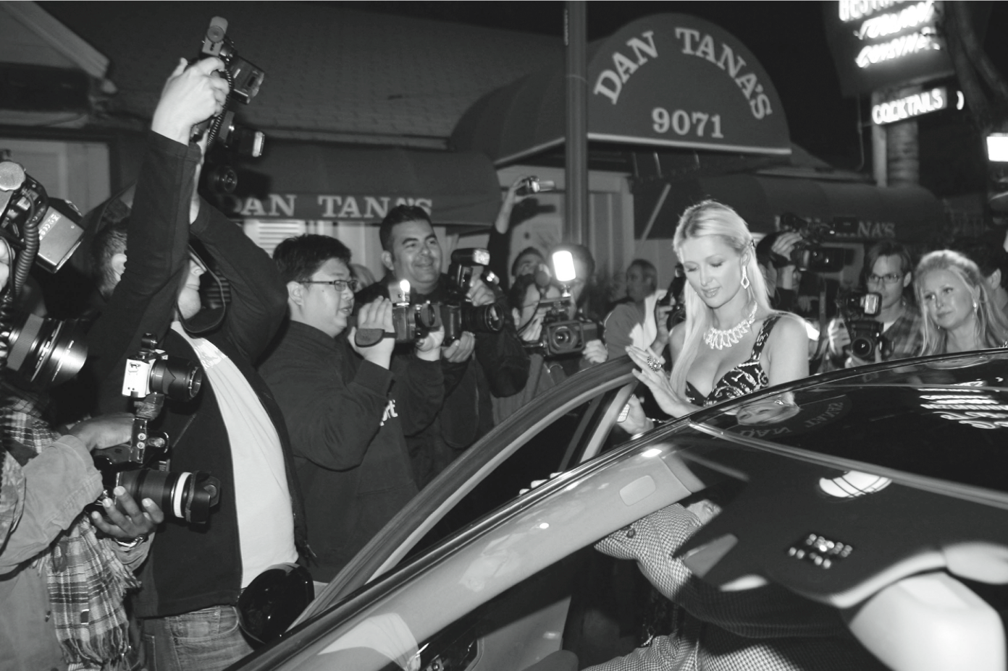
Do People Have the Right to Be Left Alone?
PhamousFotos / Splash News/Newscom
1-<number>

Slide 6
Privacy and Trust
Perhaps modern life is actually more private than life centuries ago
  Most people don’t live with extended families
  Automobile allows us to travel alone
  Television v. public entertainment
Challenge: we now live among strangers
Remedy: establishing reputations
  Ordeal, such as lie detector test or drug test
  Credential, such as driver’s license, key, ID card, college degree
Establishing reputation is done at the cost of reducing privacy
1-<number>

Slide 7
Case Study: New Parents
Sullivans have a baby girl
Both work; they are concerned about performance of full-time nanny
Purchase program that allows monitoring through laptop’s camera placed in family room
They do not inform nanny she is being monitored
1-<number>

Slide 8
Rule Utilitarian Evaluation
If everyone monitored nannies, it would not remain a secret for long
Consequences
  Nannies would be on best behavior in front of camera
  Might reduce child abuse and parents’ peace of mind
  Would also increase stress and reduce job satisfaction of child care providers
  Might result in higher turnover rate and less experienced pool of nannies, who would provide lower-quality care
Harms appear greater than benefits, so we conclude action was wrong
1-<number>

Slide 9
Social Contract Theory Evaluation
It is reasonable for society to give people privacy in their own homes
Nanny has a reasonable expectation that her interactions with baby inside home are private
Sullivan’s decision to secretly monitor the nanny is wrong because it violates her privacy
1-<number>

Slide 10
Kantian Evaluation
Imagine rule, “An employer may secretly monitor the work of an employee who works with vulnerable people”
If universalized, there would be no expectation of privacy by employees, so secret monitoring would be impossible
Proposed rule is self-defeating, so it is wrong for Sullivans to act according to the rule
1-<number>

Slide 11
Virtue Ethics Evaluation
Sullivans are responsible for well-being of their daughter
Chose nanny through concern for baby: characteristic of good parents
Daughter is truly defenseless, unable to communicate with them
Decision to monitor can be viewed as characteristic of good parents
Would also expect them to cease monitoring once assured nanny is doing well
1-<number>

Slide 12
5.3 Information Disclosures
1-<number>

Slide 13
Public Records
Public record: information about an incident or action reported to a government agency for purpose of informing the public
Examples: birth certificates, marriage licenses, motor vehicle records, criminal records, deeds to property
Computerized databases and Internet have made public records much easier to access
1-<number>

Slide 14
Records Held by Private Organizations
Credit card purchases
Purchases made with loyalty cards
Voluntary disclosures
Posts to social network sites
1-<number>

Slide 15
Data Gathering and Privacy Implications
Facebook tags
Enhanced 911 services
Rewards or loyalty programs
Body scanners
RFID tags
Implanted chips
OnStar
Automobile “black boxes”
Medical records
Digital video recorders
Cookies and flash cookies
1-<number>

